Slide 1
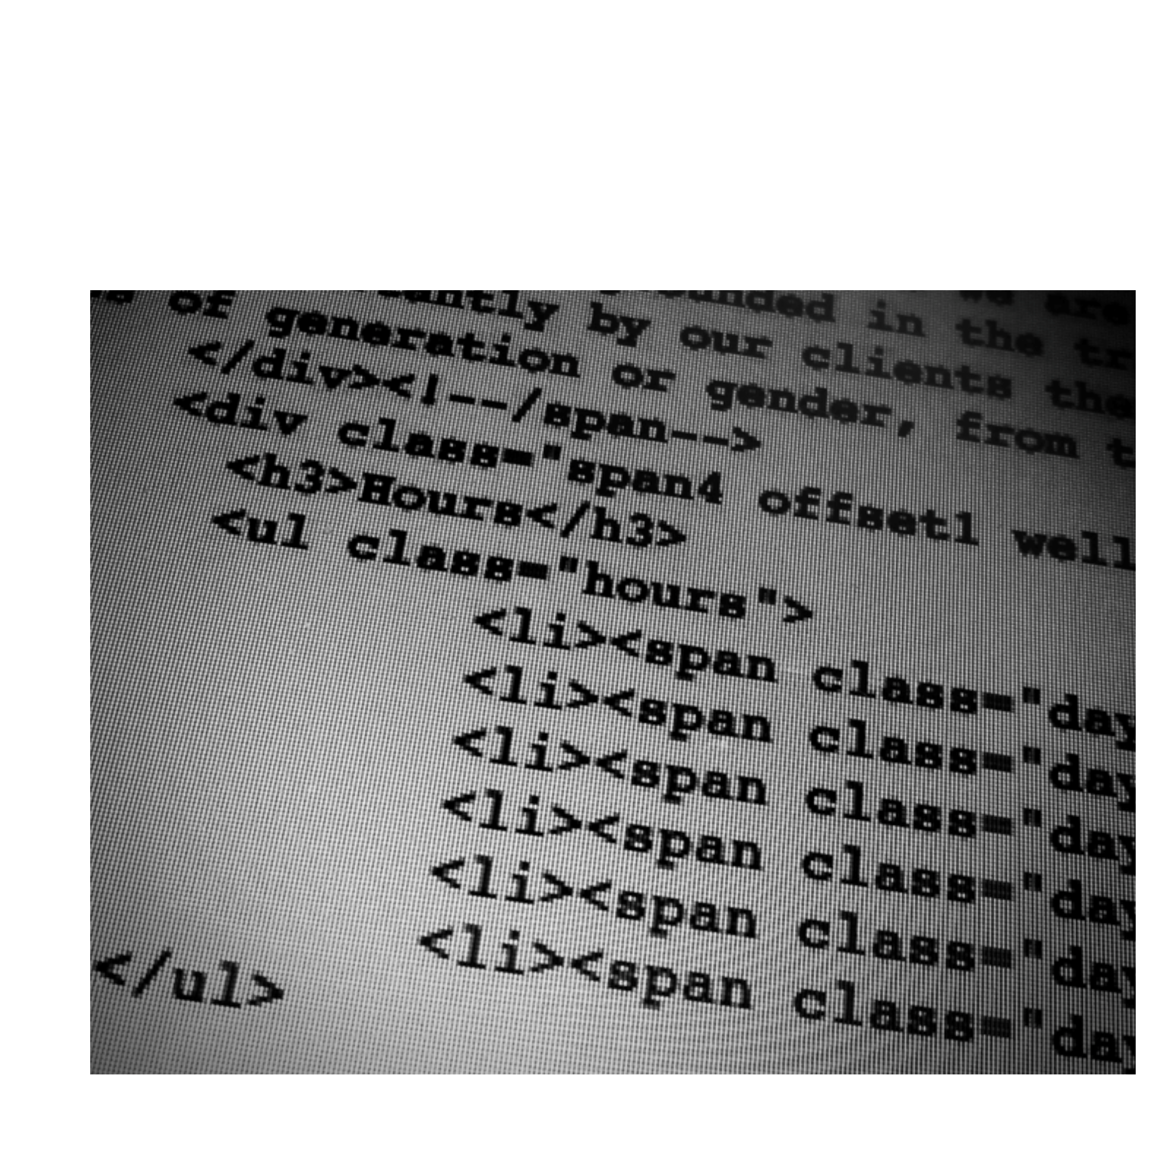

Lunch & Learn: CSS

Slide 2
CSS

Slide 3
Cascading
+
Style Sheet

Slide 4
The Stylesheet
A stylesheet is a set of rules defining
how an html element will be “presented”
in the browser.
These rules are targeted to specific elements in the html document.

Slide 5
The Cascade
The “cascade” part of CSS is a set of rules for resolving conflicts with multiple CSS rules applied to the same elements.
For example, if there are two rules defining the color or your h1 elements, the rule that comes last in the cascade order will “trump” the other.

Slide 6
Browser stylesheet Linked
(external) stylesheet
Embedded (internal) stylesheet
Inline (internal) Styles
low importance
high importance

Slide 7
Inheritance
Most elements will inherit many style properties from their parent elements by default.
HTML relationship
<body> parent of site
<div> parent of ul and li, child of body
<ul> parent of li, child of div and body
<li></li> child of ul, div, and body
</ul>
</div>
</body>

Slide 8
Inheritance
body
make the paragraph 16px, Verdana, red
p
make the paragraph blue
16px, Verdana, blue

Slide 9
Specificity
Shortly after styling your first html elements,
you will find yourself wanting more control over where your styles are applied.
This is where specificity comes in.
Specificity refers to how specific your selector is in naming an element.

Slide 10
Specificity
body
make the paragraph 16px, Verdana, red
p
make the paragraph blue
p.pink
make the paragraph pink
16px, Verdana, pink

Slide 11
HTML
<div id=”plan-2323”>
<p>Here is some text.</p>
<p>Hide this text.</p>
<div>
<div id=”plan-2323”>
<p>Here is some text.</p>
<p class=”hideclass”>Hide this text.</p>
<div>
CSS
#plan-2323.hideclass {display: none}

Slide 12
CSS Syntax
Syntax = the rules for how to write the language

Slide 13
Three terms for describing your styles:
CSS rule CSS
selector CSS
declaration

Slide 14
CSS Rule
selector {property: value;}
declaration
Every style is defined by a selector and
a declaration. The declaration contains at least one property/value pair.Together they are called a CSS Rule.

Slide 15
CSS Selector
body {font-family: Arial, Helvetica}
p {color: #666666}
h1 {font-size: 24px}
a {color: blue}
The selector associates css rules with
HTML elements.

Slide 16
CSS Selector
p {
color: red
}
The selector is typed in front of the declaration, with a space separating it and the opening
curly-bracket (aka curly-brace).
Typically, extra spaces and returns are added as shown for the sake of readability.

Slide 17
CSS Selector
h1,h2,h3,h4 {
font-weight: bold
}
You can apply styles to multiple selectors in the same rule by separating the selectors with commas.

Slide 18
CSS Declaration
p {
property: value
}
The declaration is always defined in a property/
value pair. The two are separated by a colon.
How you define the properties will affect how
HTML elements are displayed.

Slide 19
CSS Declaration
p {
font-family: Arial, sans-serif;
font-size: 14px;
color: #666666;
}
You can apply multiple declarations to a selector(s) by separating the delcarations with semi-colons.

Slide 20
CSS Selectors

Slide 21
p Type (element)
# ID
. Class

Slide 22
Type (element) Selectors
body {declaration}
p {declaration}
h1 {declaration}
ul {declaration}
The simplest selector is the type selector, which targets an html element by name.

Slide 23
The essential selector types (elements)
Primary Body Formatting
Structure Elements Elements
html p em
body br i
h1 – h6 strong
ul b
ol q
a blockquote
img span
div

Slide 24
ID Selectors
CSS
#logo {declaration}
HTML
<img id=”logo” src=”” alt=””>
An ID is an html attribute that is added to your html markup. You reference that ID in your css with a hash.

Slide 25
Class Selectors
CSS
.ingredients {declaration}
HTML
<ul class=”ingredients”>
A class is an html attribute that is added to your html markup. You reference that ID in your css with a period.

Slide 26
IDs vs Classes
The most important difference between IDs and classes is that there can be only one ID on a page, but multiple classes.
An ID is more specific than a class. An element can have both an ID and
multiple classes.

Slide 27
IDs vs Classes
ID: #344-34-4344
Class: Male
Class: Employee
ID: #123-54-9877
Class: Female
Class: Employee

Slide 28
Descendant Selectors
CSS
#sidebar .author {declaration}
HTML
<div id=”sidebar”>
<p class=”author”></p>
</div>
A space between two selectors indicates a descendant selector. In the example above, the style is targeted to an element with the class “author” inside the id “sidebar”.

Slide 29
Multiple classes
CSS
.ingredients.time {declaration}
HTML
<div class=”ingredients time”>
<h1></h1>
</div>
Elements can have multiple classes, giving you more control. The are written in the CSS in the exact order they appear in the html, with no spaces.

Slide 30
bswift Client Stylesheets

Slide 31
Common uses:
Hiding elements Tweaking
specific text styles Branding

Slide 32
Some things you can change with CSS
colors
type
type size
backgrounds
spacing
sizes
borders
positions (layout)
Some things you can’t change with CSS
content
markup

Slide 33
Example:
Client text + Client CSS

Slide 34
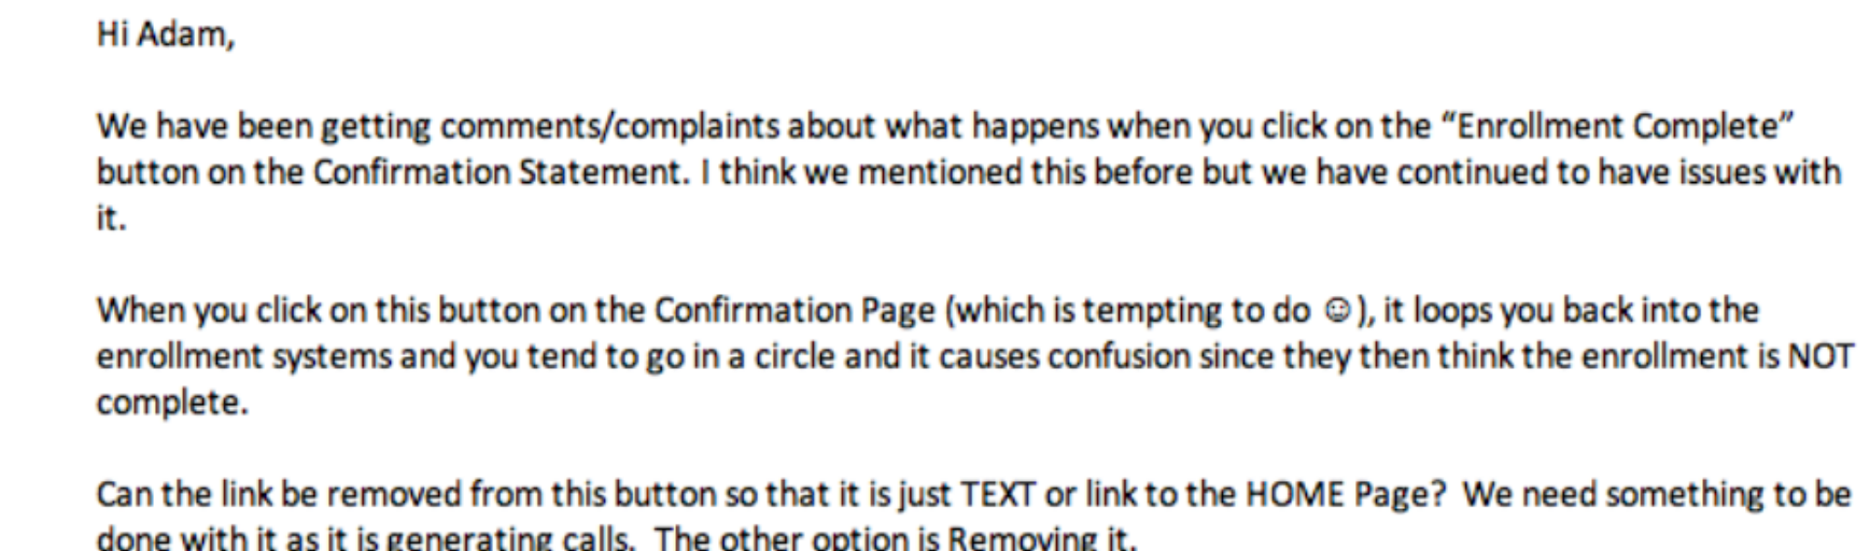


Slide 35
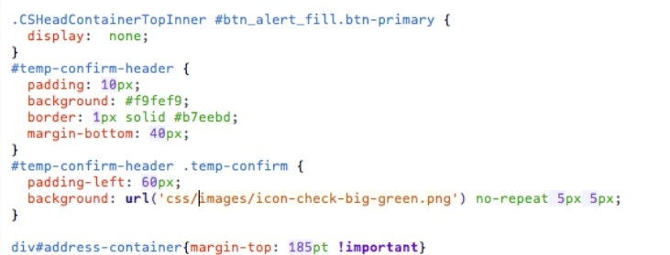


Slide 36
Example:
Login Branding

Slide 37
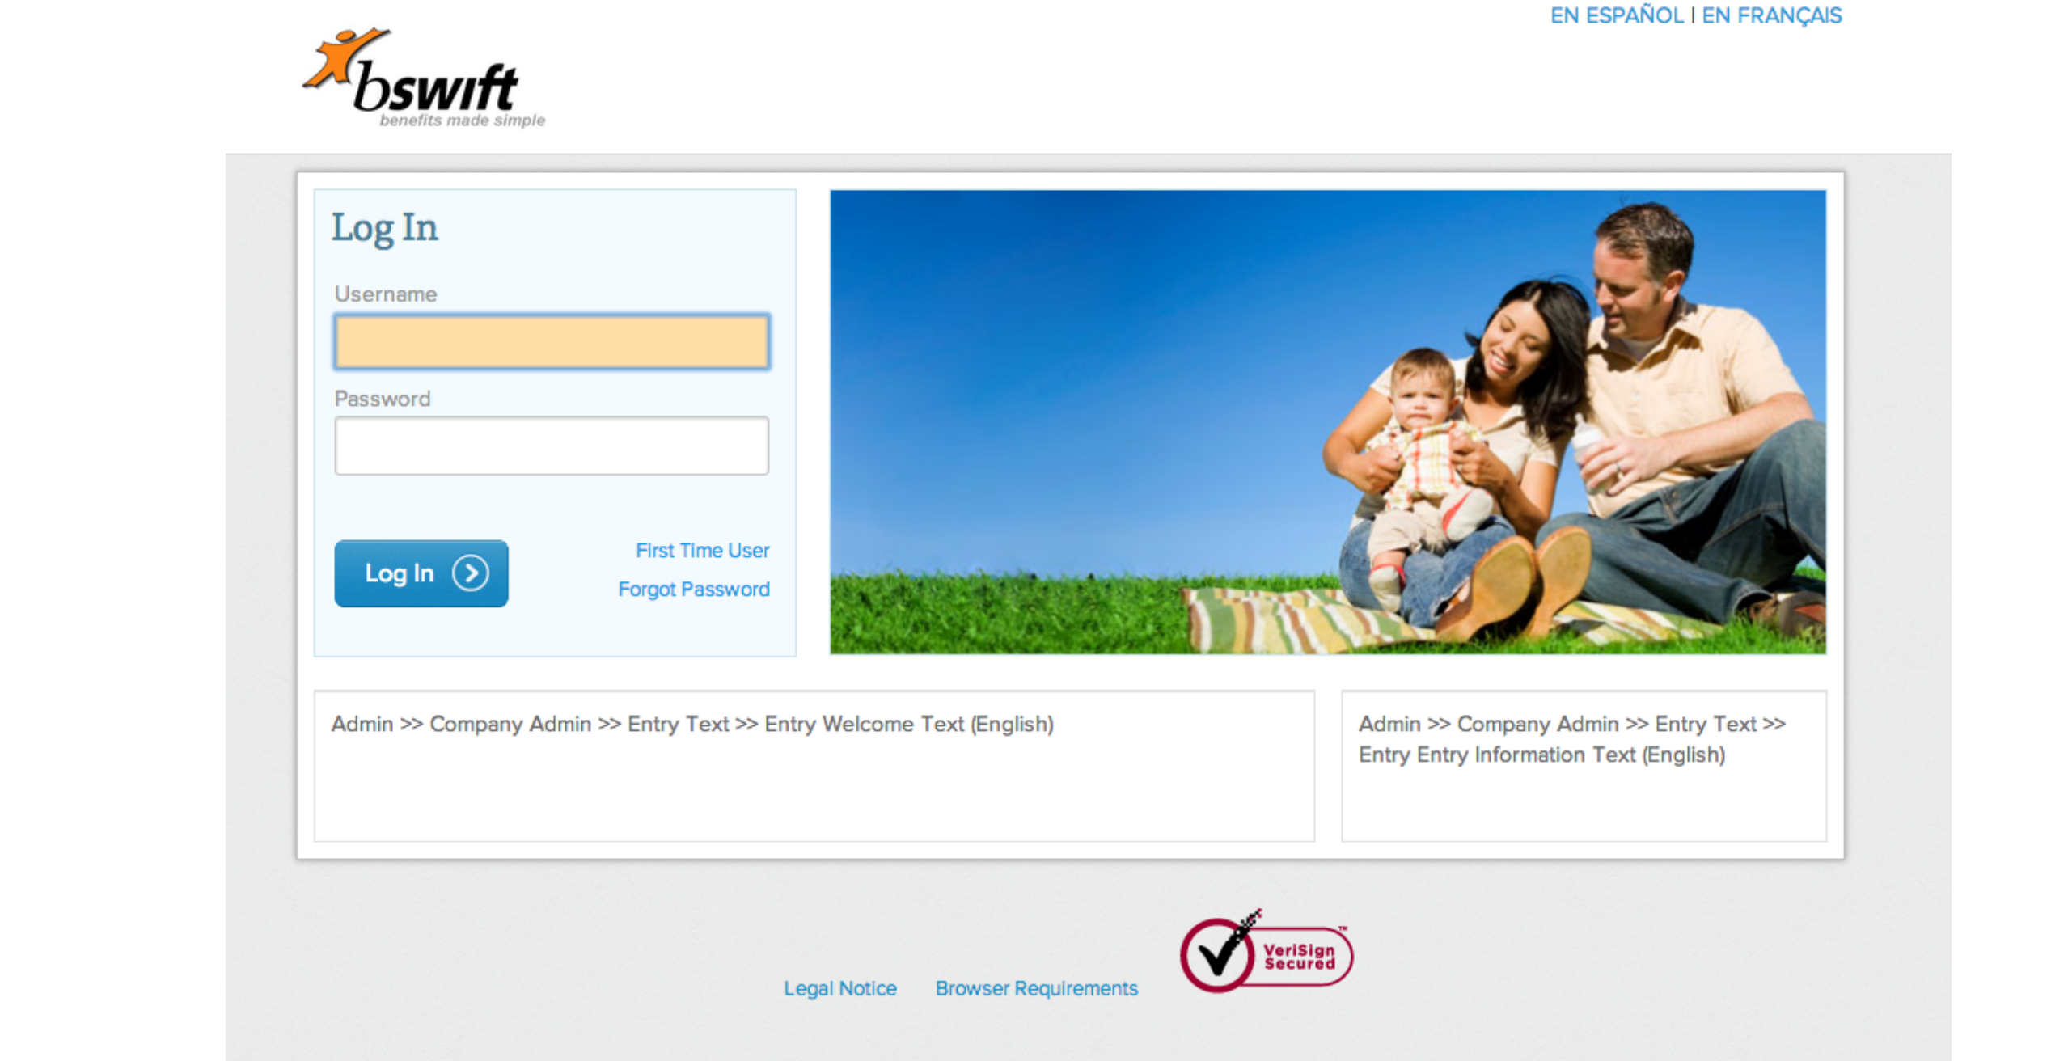

Slide 38
Example:
Login Examples

